Slide 1
SQL Server on Amazon RDS Building on the Amazon Web Services Cloud Platform
Backups and restores for RDS
John McCormack

Slide 2
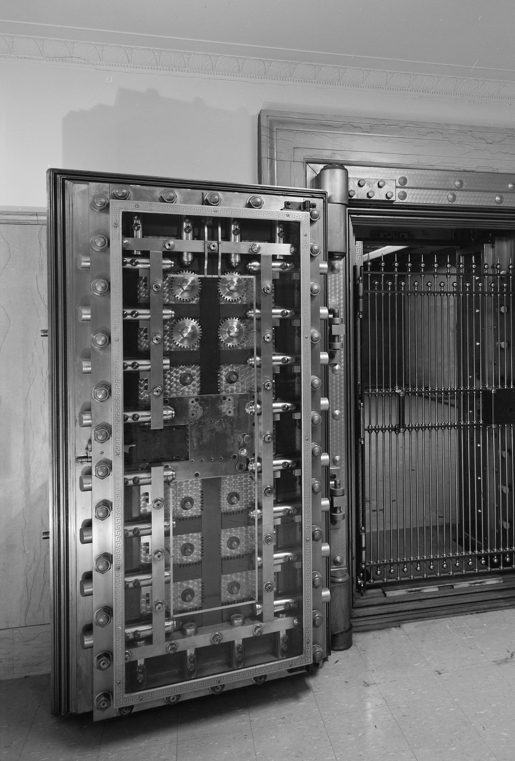

Backups and Restores for RDS
Automated backups
Set your own retention period (0 – 35 days)
Point in time restores (within 5 minutes)
Native backup/restore to/from S3
Must change option group to allow
Must use IAM role to grant permission to your S3 bucket
Take ad-hoc snapshots
Kept until deleted by user
Initiated via PowerShell, CLI, API or AWS console
Snapshots can be shared between accounts (prod to dev)
Accounts are similar to subscriptions in Azure
You can restore a full RDS instance to a new RDS instance from a snapshot

